Slide 1
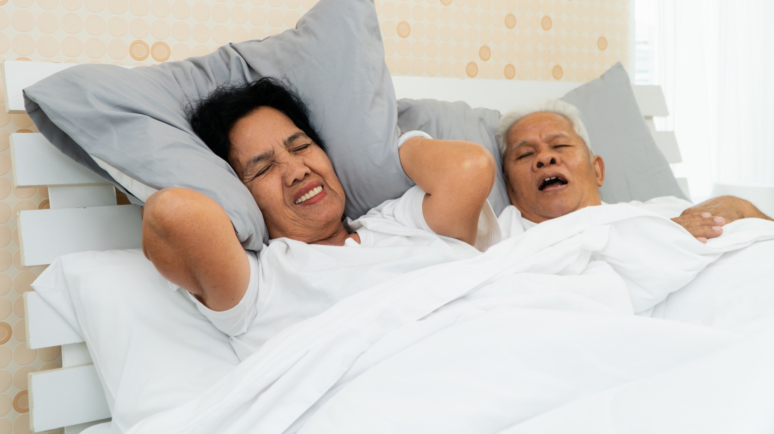
Treating Your Snoring and Sleep Apnea
How a Dentist Can Help

Slide 2
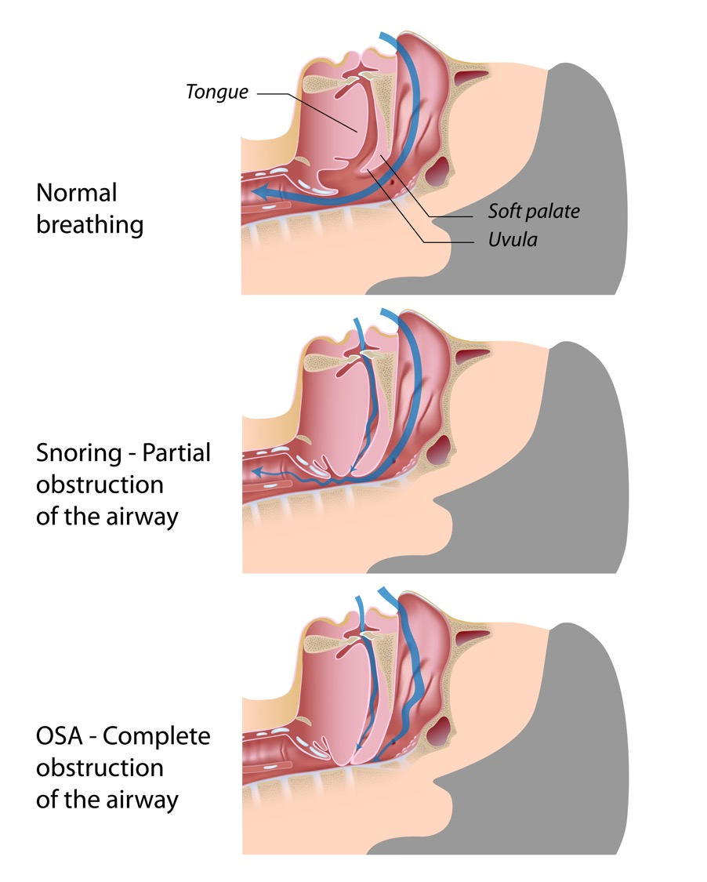
Snoring and Obstructive Sleep Apnea (OSA)
Notes:
SNORING:
Snoring occurs when soft tissues vibrate in your upper airway while you sleep.
Snoring is more common in men, but women can snore too. It is more common in women during pregnancy and menopause.
Smoking and alcohol use can lead to snoring, and its also more common as weight increases or when you have trouble breathing through your nose.
Snoring can be a sign of OSA, but can also occur on its own. Not all snorers have OSA. In this graphic, you can see the difference in obstruction between snoring and OSA.
Snoring, sleep apnea and sleep deprivation are very, very common in the US. 40% of adult men and 24% of adult women snore
OSA:
OSA happens when soft tissue around the airway relaxes and collapses during sleep. When your muscles relax, they can then collapse and block your airway.
These breathing pauses, or apneas, temporarily cause dips in oxygen.
Sleep apnea is very common in the US. One study estimates that as many as 54 million Americans have OSA.
OSA can cause you to stop breathing hundreds of times per night for anywhere from a few seconds to more than a minute. This can cause you to wake up many times, without you even realizing it.
This can make sleep unrefreshing, leading you to be tired when you wake up.
Beyond fatigue, this constant sleep interruption can lead to many health problems.

Slide 3

Possible Signs of OSA
Snoring
Choking or gasping while sleeping
Waking up unrefreshed
Being tired during the day
Morning headaches
Frequent use of the bathroom at night
Difficulty concentrating or remembering things
Notes:
There are a few signs and symptoms that we typically look for when trying to figure out if a person has OSA. Some questions that we tend to ask are:
Do you snore?
Does your bed partner say you choke or make gasping sounds while sleeping?
Do you wake up in the morning feeling unrefreshed?
Are you tired during the day?
Do you have morning headaches?
Do you wake up frequently at night to go to the bathroom?
Do you have difficulty concentrating or remembering things?
Based on your screening, here is where you might be exhibiting some of these signs [refer to screening data for patient].

Slide 4

OSA Can Impact Your Quality of Life
Notes:
If you have OSA and are not getting refreshing sleep at night, this can lead to a great deal of fatigue.
Whether you find yourself falling asleep while watching TV with your partner, catch yourself dozing off while driving or find that you are becoming less productive at work, fatigue caused by OSA can negatively impact your quality of life.

Slide 5
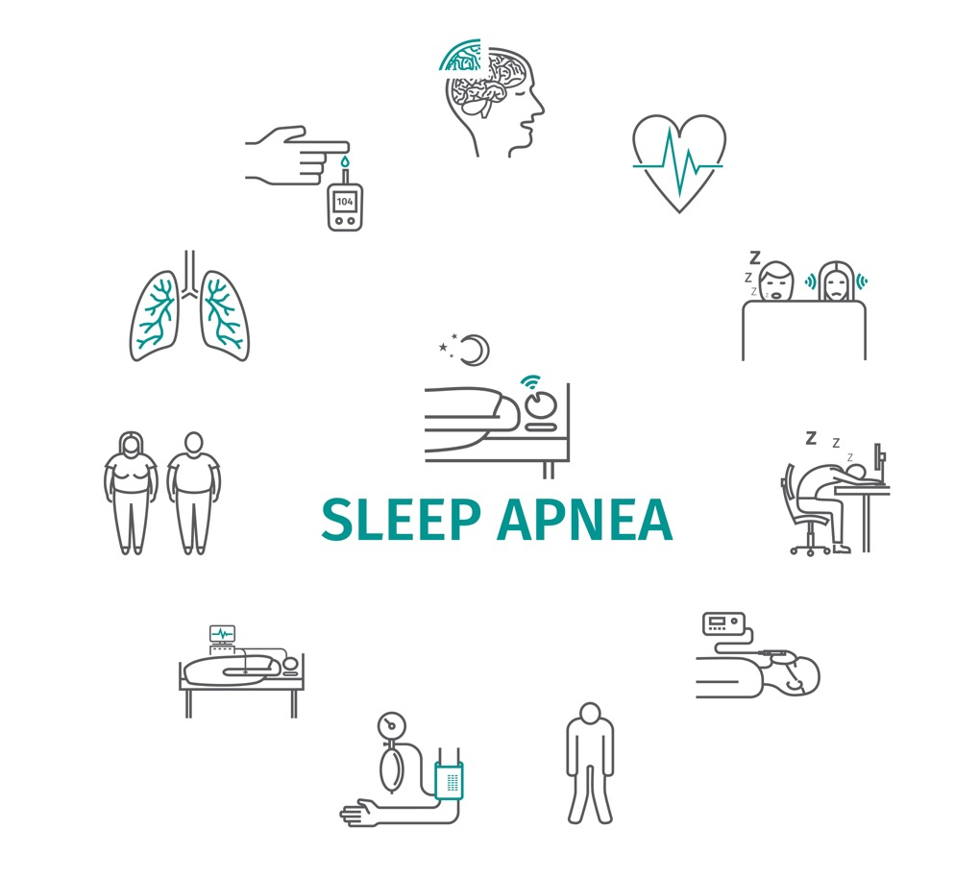
Health Problems Associated with OSA
Diabetes
Heart disease
Cognitive issues
Impaired immune system
Other serious diseases
Notes:
Beyond fatigue, OSA can also cause a number of serious side effects.
Research has shown that having OSA might make it more likely that you have other serious health conditions like:
Diabetes
Heart problems like high blood pressure, or increased stroke risk,
Thinking problems like brain fog or increased risk for dementia and Alzheimer's disease
Immune system less able to fight off infections
Even other serious diseases like cancer have been linked to OSA
Research also shows that treating OSA can reduce our risk of these serious conditions.

Slide 6
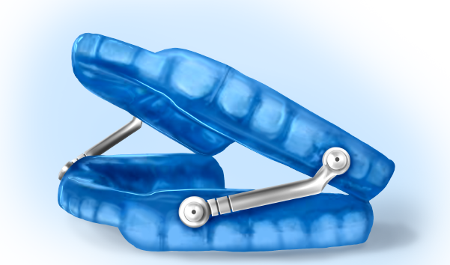
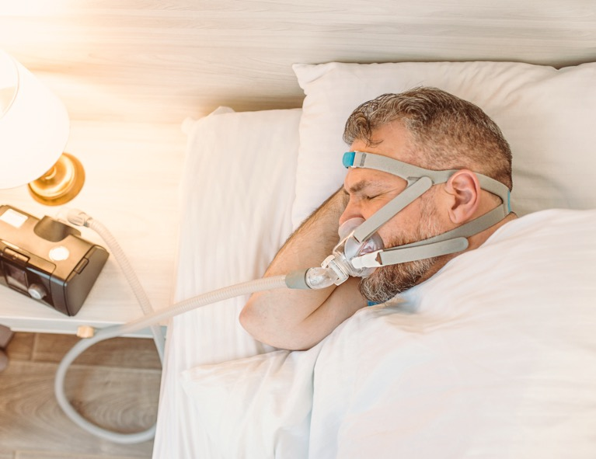
Hypoglossal Nerve Stimulation
What are my treatment options?
Surgery
Notes:
There are a number of treatment options for OSA. These range from CPAP machines, appliances that you can wear at night to open up your airway to more invasive options like surgery.
One treatment you may have heard about recently on commercials is hypoglossal nerve stimulation. This works by implanting a medical device that will send an electrical current to stimulate the hypoglossal nerve. The electrical currents sync with your breathing and cause your tongue to move forward and out of the way of obstructing your airway.
When it comes to treating OSA, keep in mind that your therapy only works while you are using it. If you aren't wearing your CPAP or dental appliance when you sleep, you will still snore or have apnea. Surgical treatments are more permanent, but these are reserved for the most severe cases. It's important that you pick a treatment that you can see yourself using all night, every night.

Slide 7
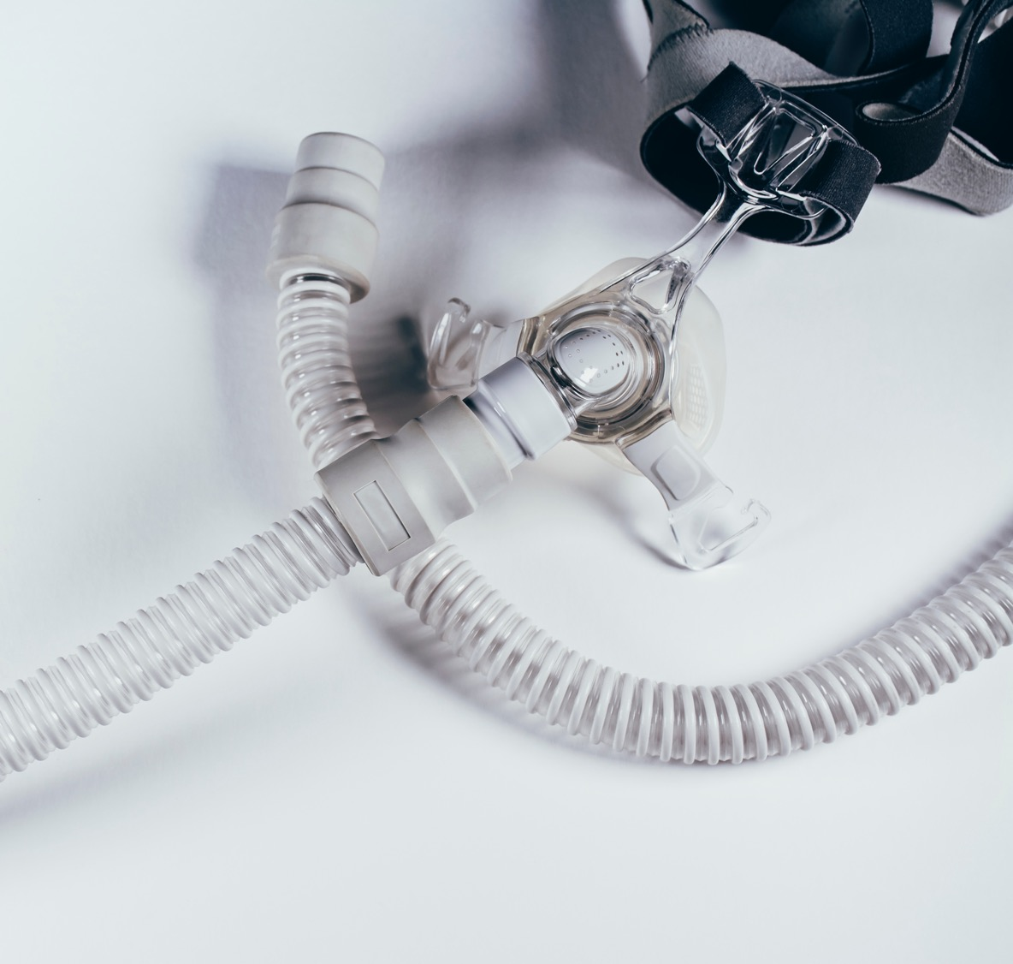
Oral Appliance Therapy is as Effective as CPAP
Notes:
CPAP is a commonly prescribed treatment and can be an effective therapy if you wear it all night long, every time you sleep.
With a CPAP machine, you wear a mask with a tube that is hooked up to a machine and it blows air down your throat while you sleep. There are all types of masks available. Some of these types of masks can lead to mouth breathing, which can lead to dry mouth and discomfort. Other patients do not like the noise of a CPAP machine or how bulky they are. Additionally, you have to get new tubes and masks several times throughout the year, You also need electricity and most often distilled water. These are just a few of the reasons that people tend to give up using their CPAP.
On the other hand, people tend to prefer oral appliance therapy because appliances are light weight, quiet, easy to use and comfortable to wear.
Study after study has shown that OAT can be just as effective as CPAP in treating OSA. While CPAP works quite well in lab settings, in the real world, patients do not tend to like the treatment as much and thus, do not use it as much as CPAP. An oral appliance can help you just as much as CPAP, because you are more likely to use it every time you sleep.

Slide 8
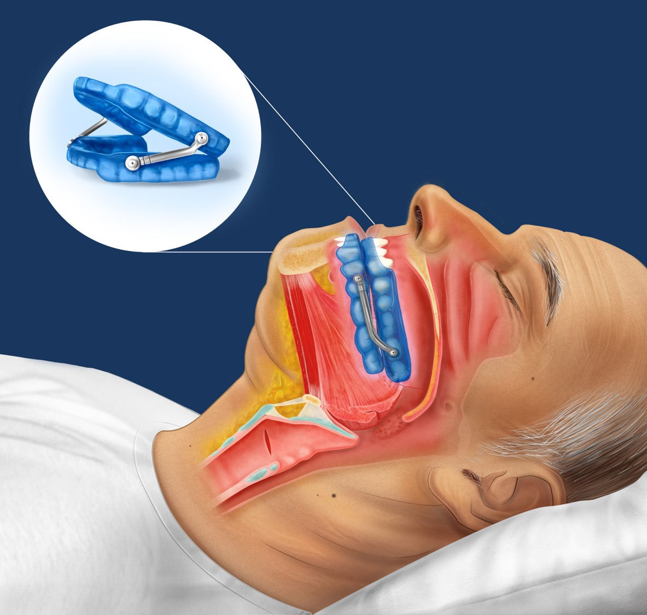
What is
an Oral Appliance?
Notes:
Another option that patients tend to like, that are comfortable and that you will likely regularly wear, oral appliances may be a good option. A trained dentist, like myself, can help provide you with this appliance.
You might be wondering, what exactly is an oral appliance? Oral appliances can help treat both snoring and sleep apnea.
An oral appliance is a device worn in the mouth only during sleep. It fits like an orthodontic retainer. A custom-fit oral sleep appliance is an effective treatment that prevents the airway from collapsing by supporting the jaw in a forward position.
OAT can be used for both snoring and OSA! In fact, new research shows that oral appliances can effectively treat mild, moderate and even severe sleep apnea.
If you are interested in an oral appliance, we can do an examination of your teeth and airway and then take impressions to make a custom oral appliance, specifically tailored to you.

Slide 9
1
2
3
Screening
Do you have
any symptoms?
Diagnosis
Talking with
your doctor
Making & Fitting Your Oral Appliance
Personalized for every patient
6 Steps for Starting Oral Appliance Therapy
4
5
6
Getting Your Appliance in the Right Position
Comfort is
top priority
Follow-Up Visits
Is the device doing its job?
Living with an Oral Appliance
Ease of use means ease
of mind
Notes:
Screening
Qualified dentists ask a number of screening questions.
Your height, weight and blood pressure are taken.
You might also have an X-Ray or pictures taken of your mouth.
Diagnosis
Be prepared for a sleep evaluation and sleep test.
PAP therapy is the most common treatment for OSA.
Oral appliances are effective, less invasive and more comfortable.
Making & Fitting Your Oral Appliance
Impressions will be taken to make a custom appliance just for you.
Adjustments will be made by your dentist as needed.
Learning how to properly care for your device is important.
Getting Your Appliance in the Right Position
An open airway and a comfortable fit is the goal.
You might be asked to run a few tests while you sleep.
Your physician is kept update on your treatment.
Follow-Up Visits
Your qualified dentist will schedule yearly assessments.
These appointments are about making changes if needed.
The top goal is to make sure you're comfortable.
Living with an Oral Appliance
OAT is small, quiet, easy to use and comfortable.
Getting the right treatment is helping your overall health.
Qualified dentists can get your treatment right today!

Slide 10
Side Effects
  Patients can experience side effects from oral appliance therapy
  Side effects tend to be mild and correctable
What About Side Effects?
  Qualified Dentist
Remedies
  Reducing discomfort
  Using daytime appliances & exercises
  Fixing any appliance issues
Notes:
What about side effects of oral appliance therapy?
While some patients may experience side effects like jaw discomfort, changes in bite or teeth or issues with the appliance, these tend to be very minor and easily correctable.
A qualified dentist is trained in how to minimize side effects using techniques to increase comfort. This could include using exercises or a morning device to strengthen the jaw or fixing any trouble spots on the appliance.
Most patients tend to be very satisfied with their oral appliance and find them very comfortable! The benefits gained from treating OSA can vastly improve quality of life.

